Slide 1
Update on EarthCube
Unidata Policy Committee
May 2012

Slide 2
Status
Activities
Charrette
EarthCube and the Community

Slide 3
Activities
Awards 7 Concepts
6 Community
1 Workshop
1 Stakeholder study
Community Groups 15 active all working on roadmaps
Website >900 members Frequent updates
NSF EarthCube Staff Participation 5 GEO 3 OCI 2 CISE ~10 POs

Slide 4
Charrette
Dates: June 12-14
Place: Rosslyn
Attendance: 150 on-site & ~ 100 virtual (est.)
Objectives: Integrate the efforts
Outcome: Roadmaps
Enhancements: Early Career scientists & observers and provocateurs
Approach: Flexible agenda

Slide 5
Partnership, Stakeholder Alignment and Community Engagement
EarthCube and the community

Slide 6
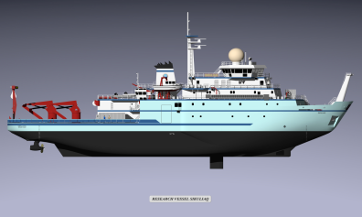
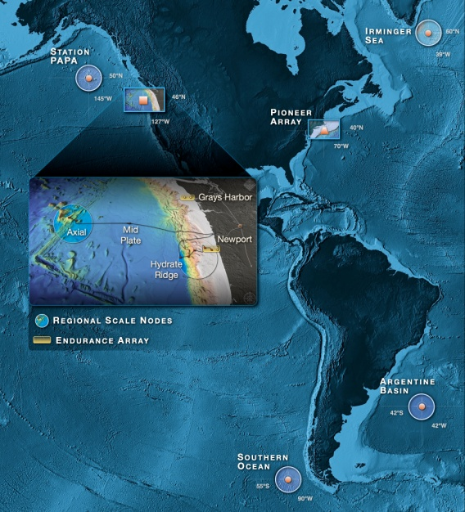

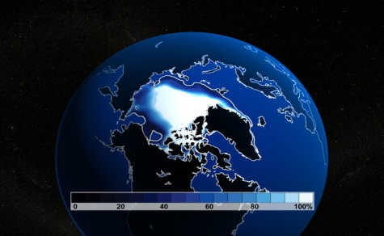

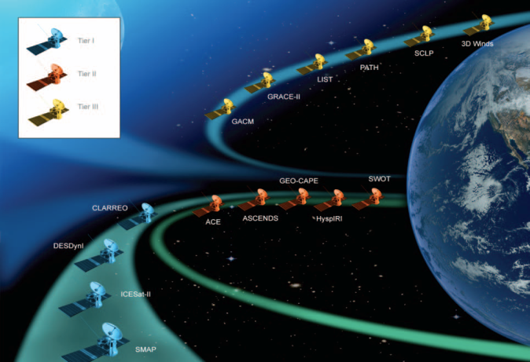
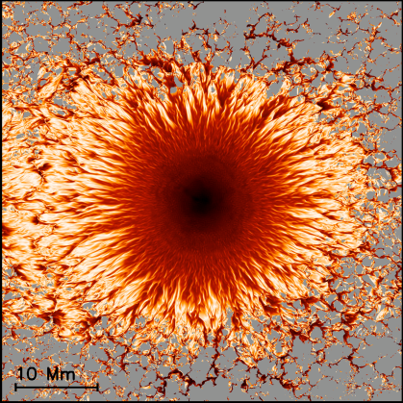
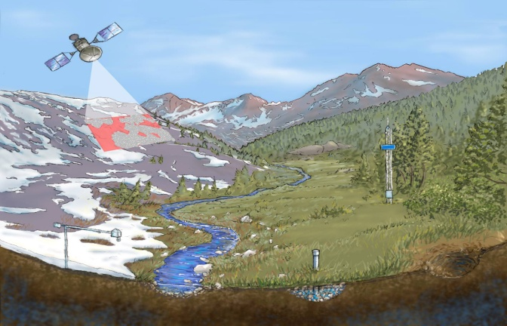
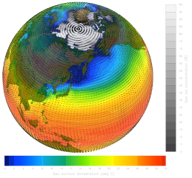
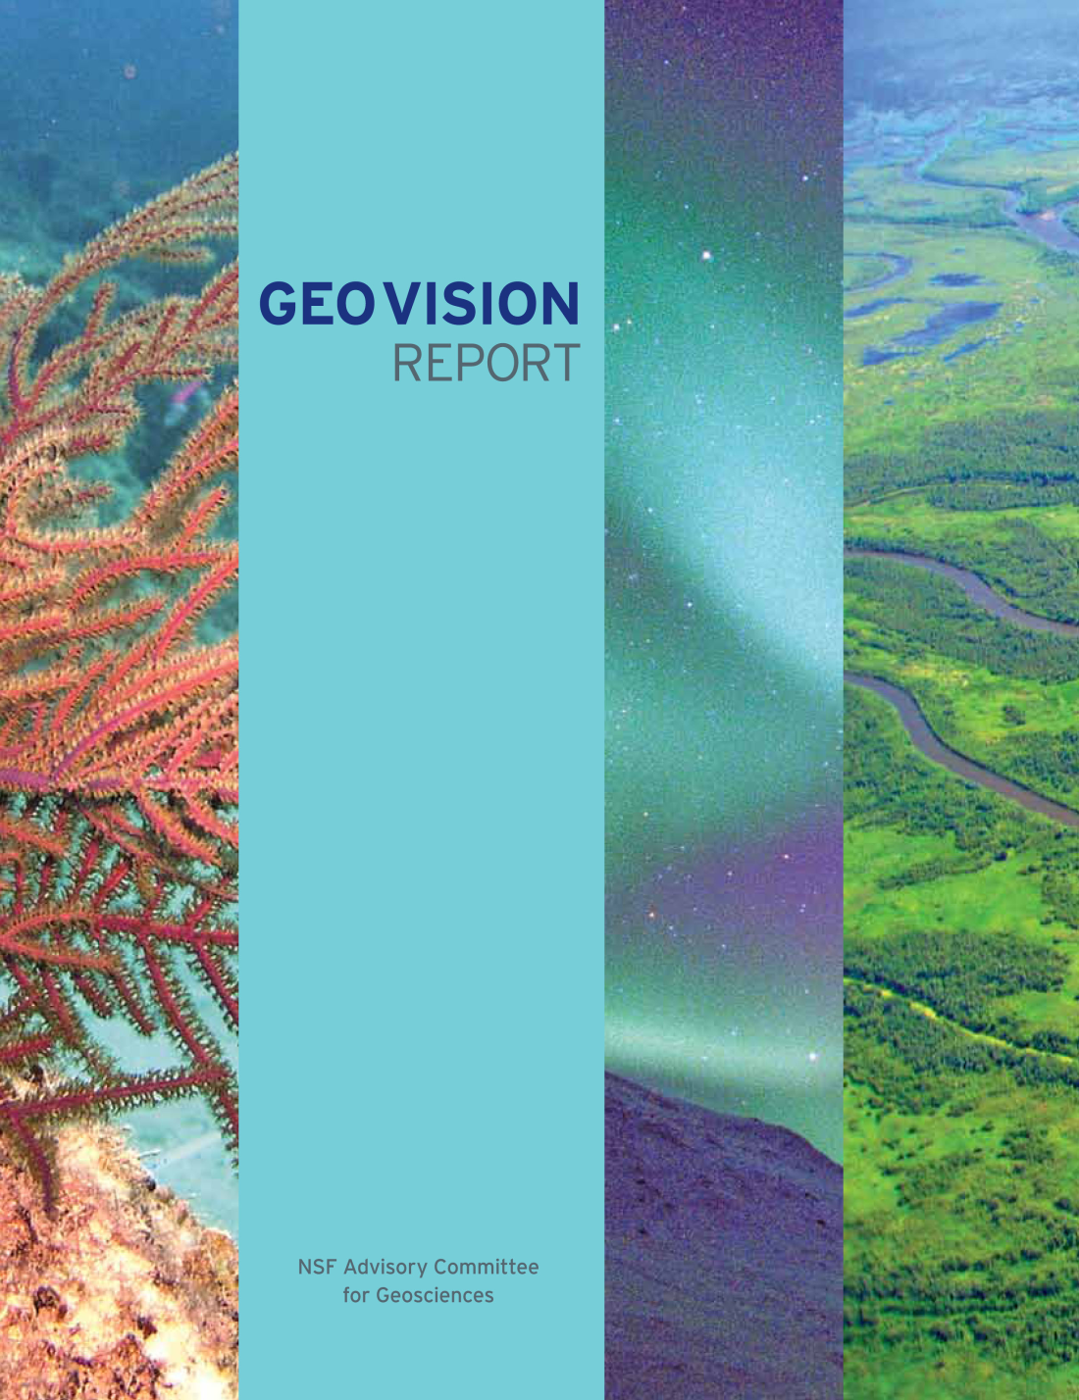
Context & Partnership
GEO is increasing “born-digital”
CyberInfrastructure For the 21st Century (CIF21)
Builds national infrastructure for S&E
Leverages common methods, approaches, and applications – focus on interoperability
Catalyzes other CI investments across NSF
Provides focus and is a vehicle for coordinating efforts and programs
Based upon a shared governance model involving every directorate and office
Managed as a coherent program by OCI
EarthCube is GEO contribution to CIF21
Arctic Sea Ice
Oceans
EarthScope Observatory
The Science Context
Water
Satellites
Earth System Modeling
The Dynamic Earth
Water: Changing
Perspective
GEO CI
The Changing Climate
Geosphere- Biosphere Connections
Earth and Life

Slide 7
The EarthCube Vision
An alternative approach to respond to daunting science and CI challenges
EarthCube is an outcome and a process
EarthCube will require broad community participation
Unidata
CUASHI
OOI
IRIS
IEDA
NCAR
Notes:
So I want to spend the second half talking to you about the EarthCube effort, what we intend to accomplish, and how. In it’s heart we want this to be a community-building and driven effort. But at least in GEO, we have not engaged the community we support in this way, and some of the steps are not clear.

Slide 8
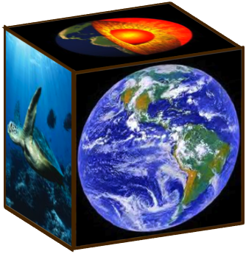
EarthCube Goal and Outcomes
Goal
To transform the conduct of research in geosciences by supporting the development of community-guided cyberinfrastructure to integrate data and information for knowledge management across the Geosciences.
Transform practices within the geosciences community spanning over the next decade
Provide unprecedented new capabilities to researchers and educators
Vastly improve the productivity of community
Accelerate research on the Earth system
Provide a knowledge management framework for the geosciences
Outcomes
Notes:
Given the challenges of our scientific community, we expressed the goal of EarthCube as facilitating the transformation of geosciences research by supporting the community-driven CI to integrate data and information across the entire geosciences. We hope that when realized, it will over the next decade transform the practice of the community, provide new capabilities for researchers and educators, allow them to be more productive and of course accelerate research on the Earth System through the creation of a knowledge management framework.

Slide 9
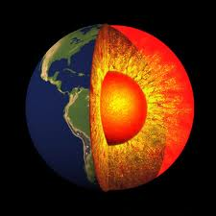


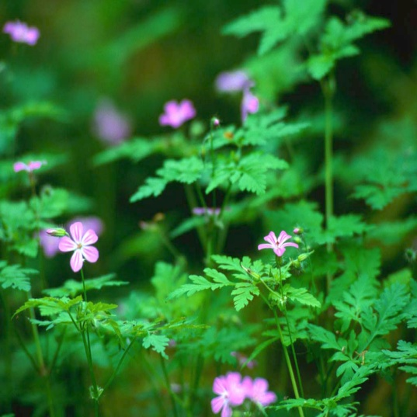


Strategic Convergence Using “Spiral Development”
10 Years
Notes:
But we also see EarthCube not just as something but as a process.
We will take a concept from the software development realm and use a spiral development process to coordinate the community development.
What we have now is disconnected cyberinfrastructure that serves specific communities well, but is mostly siloed, interoperability is scarce, connections between resources are not robust. The spirals are phased developments into better integrated systems, where each phase is assessed for its functionalities and further developments are informed by this progress. In building earthcube, we think this will be at least a 10 year process. And at the end we will have a better connected system of cyberinfrastructure.
This may not be the end of the development of EarthCube. Indeed, with technology being refreshed so rapidly, we prefer to have in place a framework to allow further community-run developments of the system. So the spiral may continue well into the future

Slide 10
Strong but uneven engagement of the geosciences and cyberinfrastructure communities
Recent Activities

Slide 11
Social Network Site
http://earthcube.ning.com/
~940 members to the EarthCube website
113 white paper submission;185 respondents to user survey
~70 expression of interest emails
12 Community Groups
Unknown number of hours of pro bono contributions by the community
Unprecedented view of the pulse of the geosciences community
Significant International Engagement
Notes:
The EarthCube website was and is an effective tool for community dialog.
Thank you for your contributions!
Exceeded our expectation
The creativity and dedication of the geosciences community demonstrated
Legacy created with the EarthCube website, whitepapers and user survey
Excellent start to broad engagement
Contributions remind us of the breadth of, and interest in, geosciences
Sustaining and enhancing the engagement is a goal for NSF

Slide 12
Timeline
Accelerating the Community Dialog
Defining the initial scope of EarthCube
New starting point for collaboration
First DCL
Social Network Site
EAGER Phase
June 2011
July 2011
Aug 2011
Nov 2011
Dec 2011- present
Webex Community Outreach
First Charrette
Notes:
We have already begun in this spiral development. The timeline so far has included several different ways of engaging the community. We first engaged the community with a Dear Colleague Letter describing EC in June 2011. We continued with outreach through Webexes and set up a social networking

Slide 13
Timeline
End-user engagement events
First Awards
Charrette II
Mar – May, 2012
June, 2012
~Sept 2012
Sept -Nov 2012
2012 -2013
Chapeau Solicitation
Chapeau
Amendment 1
More
EAGER
Awards?
Chapeau
Amendment 2
Notes:
We have already begun in this spiral development. The timeline so far has included several different ways of engaging the community. We first engaged the community with a Dear Colleague Letter describing EC in June 2011. We continued with outreach through Webexes and set up a social networking

Slide 14
Working Groups
Concept Prototyping X
Concept Prototyping Y
Concept Prototyping Z
WG Rules of Engagement, e.g.
Guiding principles
Function
Participation
Output
Timeline, etc.
Feasibility of Prototyping Outcomes to date
Roadmap through FY 14 with milestones
Community engagement, etc.
Gap Analysis
Community Event
Charrette 2
Data Discovery/Mining/Access
Semantics and Ontologies
Workflow
Governance
Data Brokering
X-Domain Interop.
Service Based Integration
Layered Architecture
Earth System Modeling

Slide 15
Spring 2015
Early EC??
Working Groups
CommunityMeeting
Not Sufficient
Working Groups
Spring 2014
Prototype1
Prototypes
Prototype2
Community
Meeting
Working Groups
Late 2012-2013
Concept Prototyping
Charrette 2
Roadmaps & Design
Jun. 2012
Community Groups
Capability Projects
Mar. 2012
Charrette 1
Requirements Analysis
Nov. 2011
Notes:
So for the long term, we have set up a framework for community engagement in building earthcube. We do reserve the right to change this in the future, adjust what we support based on community input, accelerate or decelerate components. The important thing is that these groups feed into community events but also engage in significant dialog with the NSF.

Slide 16
Early Results from Survey 357 responses
55 EarthCube community
302 Communities associated with facility or service
By Discipline:
245: geo
22: cyber
61: both
29: other
Sample Questions
This is the first I have heard of EarthCube. 183 ( 51.3% )
I am aware of EarthCube but I have no direct experience --- 93
I have visited EarthCube's web site but I am not currently participating --- 41
I have participated in EarthCube discussions, but I am not part of any EarthCube communities --- 20
I am actively involved with one or more EarthCube communities --- 18
I am assuming leadership roles within one or more EarthCube communities --- 2
By Campaign

Slide 17

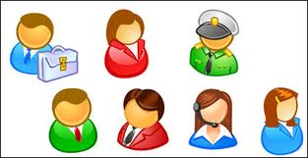

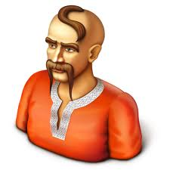



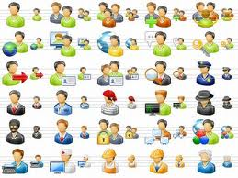



Cloud of CI EarthCube Activities
Connection to end point of use?
Workforce?
Workflow
Earth System Modeling
Security?
EC CI
Semantics and Ontologies
Data Brokering
X-Domain Interop.
Connection to end point of use?
Service Based Integration
Layered Architecture
Governance
Data Discovery/Mining/Access

Slide 18
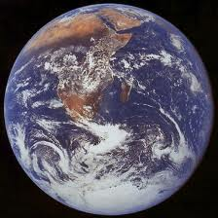
EarthCube Target Community
SHINE
Tectonics
Solar Terrestial
Petrology & Geochen
GEM
Aeronomy
EarthScope
Phy. & Dyn Met.
EAR Ed.
Magneto-spheric Phys.
CEDAR
Geophysics
Continental Dyn.
Palio-Clm
Sediment Geology and Paleobio
Hydrology
Clm & Large Scale Dyn
?
Geobio & Low Temp Geochem
NCAR
Geomomorphology & land use dyn
Atm. Chemistry
EarthCube CI
Phys Ocean
Biological Infrastructure
Marine Geology & Geo-phys
Atm. Chemistry
Ocean Drilling
?
Envir. Biology
OCE ED
Emerging Frontiers (BIO)
Biological Ocean
XSEDE
CIF 21
Chem
Ocean
OCI Program 1
OCI Program 2

Slide 19
EarthCube Lose Ends (What Keeps Up At Night)
What portfolio of activities are the necessary to engage the scientific community in the development/use of EarthCube?
How can we effectively engage our sister agencies and international partners in the dialog?
How can NSF be a more effective facilitator of collaborative dialogs among the geosciences?
How do you change the community culture?

Slide 20
Questions and/or Comments

